Slide 1
Community Tracing Collaborative | Update, What’s Ahead
Presentation to Local Board of Health Organizations
APRIL 16, 2020

Slide 2
Context | COVID-19 Contract Tracing: Extreme Challenge
People in close contact with someone who is infected with a virus, such as COVID-19, are at higher risk of becoming infected themselves, and of potentially further infecting others.
Closely watching these contacts after exposure to an infected person will help the contacts to get care and treatment, and will prevent further transmission of the virus.
Contact tracing involves three primary steps: Contact identification, Contact listing, Contact follow up
Local Boards of Health (LBOH) are current primary sources of contact tracing.
LBOHs use Massachusetts Virtual Epidemiology Network (MAVEN) to conduct the contact tracing steps.
MAVEN is system of record in MA for all case tracking and interfaces directly with the CDC, among others.
LBOHs alone are insufficient to address the large contact tracing work required in the current COVID-19 epidemic
Scenario modeling indicates that the contacts that need to be traced will grow exponentially in the upcoming weeks.
A more automated means to address case tracking enables the Commonwealth to keep pace with the burgeoning need.
Community Tracing Collaborative is the comprehensive approach to meet this challenge.

Slide 3
Team | Community Tracing Collaborative (CTC) - Members & Partners and their Roles
Command Center Lead | Provides overall direction and coordination
DPH | Maintains/manages core MAVEN database. Provides guidance on policy, protocols, scripts, etc.
Local Boards of Health* | Trusted partners and first-line Case Investigation, Contact Tracing and Community-based support
Academic Health Departments* | Schools of Public Health student, alumni, and faculty volunteers, leveraging REDCap technology
MA Connector Authority | Contracts for services and software necessary to enable CTC. Chairs the interorganizational group that reviews development priorities.
Partners in Health | Hires/deploys CTC FTEs: Case Investigators, Contact Tracers, Covid Care Resource Coordinators Coordinates with and provides augmentative support to LBOHs, AHD volunteers
Accenture | Develops and deploys virtual call center CRM technologies, and back-end connectivity to keep MAVEN the system of record.
Buoy Health | Automated self-assessment and referral for symptomatic individuals; Extending capability to include automated 14-day monitoring support for cases and contacts
Community Health Centers | Provides community-based contact center staff augmentation; via Subcontract to PIH
Other Potential Contractors | Potential staff augmentation from BCBSMA and UMMS Commonwealth Medicine
* Collaboration Partners

Slide 4
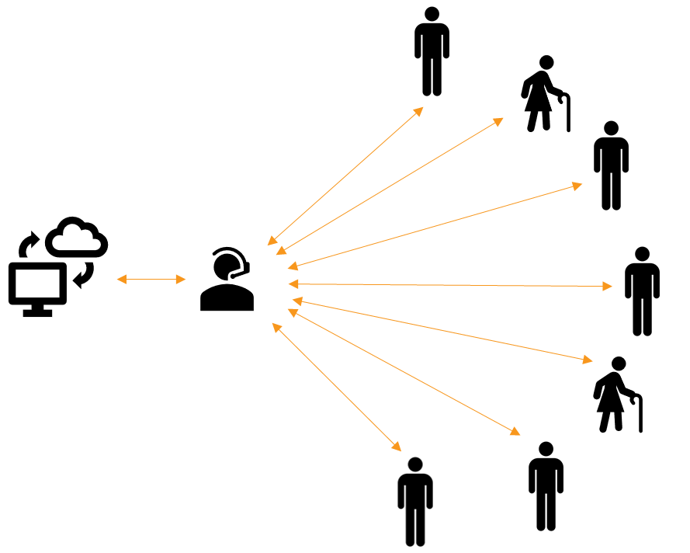
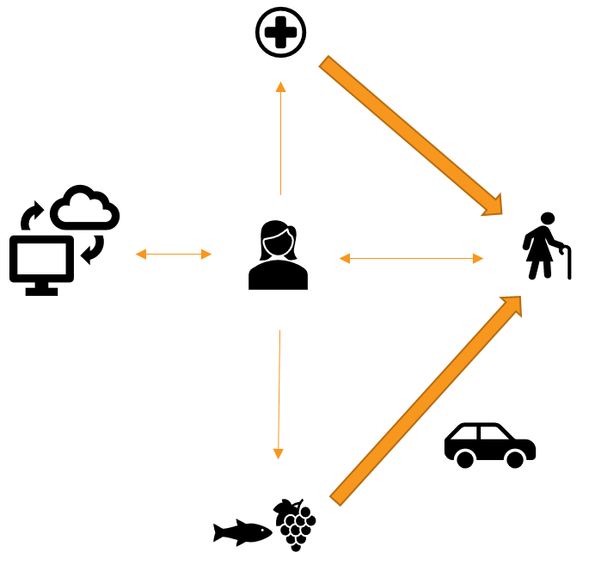
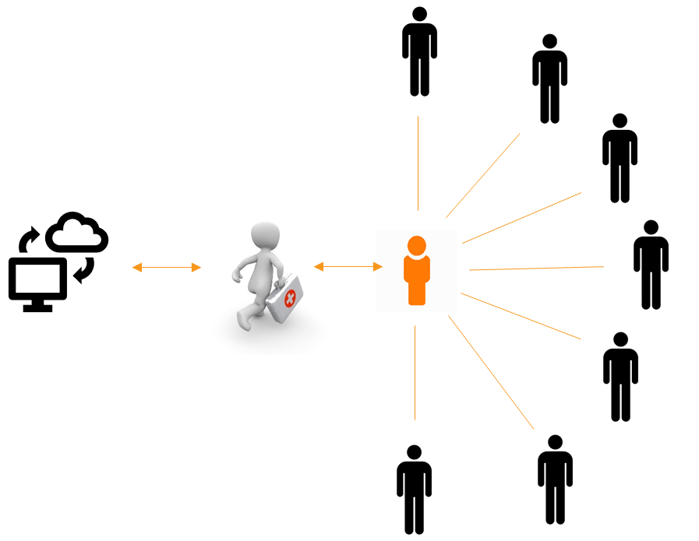
Case Investigators
Contact Tracers
Care Resource Manager

Slide 5
Current Status
3.20 | First Grants to LBOH
3.20 | Engagement of Academic Health Departments
3.27 | First AHD Student volunteers support LBOH in contact tracing. Now over 600 participating part-time.
3.28 | Governor Baker, Secretary Sudders approve concept proposal for Collaborative (CTC)
4.03 | Governor Baker announces CTC program
4.05 | Staff recruitment live. Salesforce CRM configured, integrated with MAVEN Language line up
4.12 | CTC launches with ~60 PIH staff using the 1st release of Salesforce to call a set of cases in selected towns, case data fed from MAVEN systems of record. Recruitment & training pipeline screening from 12,000 applicants (~16K as of 4/15)
4.18 | 500+ CTC staff by end of this week

Slide 6
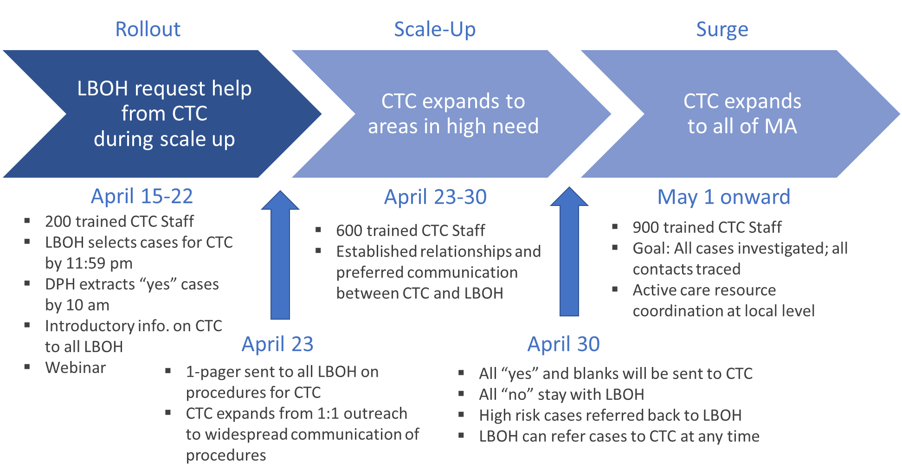
What’s Ahead? | Roll-Out Timeline

Slide 7
Want to be part of the COVID-19 solution?
Just answer the call.
We need your help. If you’ve tested positive for COVID 19,
the COVID Community Team will be reaching out via
phone to you and your close contacts to slow the spread.
We’ll make sure that you are getting the medical attention
you need and support through quarantine.
Your caller ID will show the call is coming from “MA COVID Team.”
Your name will not be released.
Massachusetts, let’s answer the call.
#COVID19MA MA Community Tracing Collaborative

