Slide 1
Westborough Police Department Electric Vehicle Presentation
Fall 2021 Special Town Meeting

Slide 2
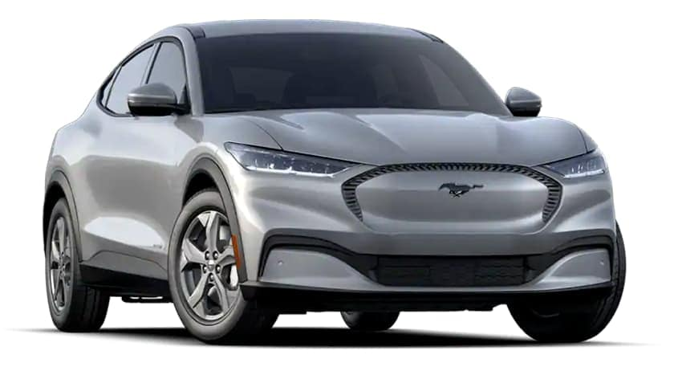
Vehicles for Comparison
2021 Ford Mustang Mach- E Premier AWD Extended Range
2021 Ford Explorer XLT AWD - ICE

Slide 3
Vehicle differences
Mustang Mach-E
Explorer XLT
AWD fully electric compact SUV
New to market in 2021
Direct competitor with Tesla Model Y and Volkswagen ID4
AWD internal combustion engine (ICE) mid size SUV
Familiarity with Police Interceptor SUV
Easy upfit as components are widely available

Slide 4
Vehicle initial costs
Mustang Mach-E
explorer xlt
MSRP: $60,229.20
Federal Tax Credit: $7,500.00
State Rebate (MOR-EV): $2,500.00
Total Cost: $50,229.20
MSRP: $39,139
Rebates : $0
Total Cost: $39,139

Slide 5
Vehicle Upfit Costs
Mustang Mach E
Explorer xlt
Vehicle after Rebates: $52,229.20
Vehicle Upfit: $ 15,353
Total: $67,582.20
Total vehicle cost : $39,139
Vehicle Upfit: $17,530
Total: $56,669
Mach-E is cheaper for upfit due to components not available for the vehicle

Slide 6
Vehicle Benefits
Mustang Mach-E
Explorer XLT
Cheaper long-term costs
Cost per mile is less
Maintenance costs are lower
No oil changes, less moving engine parts
No emission from the vehicle to operate
Cheaper up-front costs
Familiarity
No range anxiety

Slide 7
Vehicle Costs to operate for 5 years
Mustang Mach-E
Ford Exploer XLT
2021 Models | Ford Mach-E
Trim Level | Premium AWD ER
USA base MSRP (July 2021) | $69,582.00
Cost of Electric/Fuel (KWh/gal) | $0.17
Range (miles) or Avg MPG | 304
Battery Size (kWh) | 88
Cost operate per mile | $0.056
Total Mileage over 5 years | 60,000
Fuel / Electricity Cost (5 years) | $3,338.60
Service (Fluids, Brakes, Oil Change) | $300.00
Cost of Tires for 60,000 miles | $2,000.00
Federal Tax Credit | -$7,500.00
State Rebate | -$2,500.00
SUBTOTAL | $65,220.60
Cost of Ownership (5 years) | $65,220.60
2021 Models | Ford Explorer
Trim Level | XLT - AWD
USA base MSRP (July 2021) | $50,669.00
Cost of Electric/Fuel (KWh/gal) | $3.09
Range (miles) or Avg MPG | 20
Battery Size (kWh) | N/A
Cost operate per mile | $0.155
Total Mileage over 5 years | 60,000
Fuel / Electricity Cost (5 years) | $9,270.00
Service (Fluids, Brakes, Oil Change) | $1,100.00
Cost of Tires for 60,000 miles | $1,000.00
Federal Tax Credit
State Rebate
SUBTOTAL | $62,039.00
Cost of Ownership (5 years) | $62,039.00
After 5 Years the gap has closed from $8,913 to $3,181 cost to operate each vehicle.

Slide 8
Why the difference in operating costs?
Mustang Mach-E
Explorer XLT
Cost of electricity per mile: $0.045
Maintenance (Brakes) $300
Tires: $2,000
Electric cars wear down tires about twice as fast as ICE cars
5 yr. estimated electricity costs: $2,728.71
Cost to fuel per mile: $0.15
Maintenance: $1,100
Oil changes, brakes, fluid changes
Tires: $1,000
5 yr. estimated fuel costs: $9,270.00

Slide 9
Vehicle Costs to operate after 10 years
Mustang Mach-E
Explorer XLT
2021 Models | Ford Mach-E
Trim Level | Premium AWD ER
USA base MSRP (July 2021) | $69,582.00
Cost of Electric/Fuel (KWh/gal) | $0.17
Range (miles) or Avg MPG | 304
Battery Size (kWh) | 88
Cost operate per mile | $0.056
Total Mileage over 10 years | 120,000
Fuel / Electricity Cost (10 years) | $6,677.19
Service (Fluids, Brakes, Oil Change) | $600.00
Cost of Tires for 120,000 miles | $4,000.00
Federal Tax Credit | -$7,500.00
State Rebate | -$2,500.00
SUBTOTAL | $70,859.19
Eastimated Trade-In Value (After 5 yrs)
Cost of Ownership (10 years) | $70,859.19
2021 Models | Ford Explorer
Trim Level | XLT - AWD
USA base MSRP (July 2021) | $50,669.00
Cost of Electric/Fuel (KWh/gal) | $3.09
Range (miles) or Avg MPG | 20
Battery Size (kWh) | N/A
Cost operate per mile | $0.155
Total Mileage over 10 years | 120,000
Fuel / Electricity Cost (10 years) | $18,540.00
Service (Fluids, Brakes, Oil Change) | $2,200.00
Cost of Tires for 120,000 miles | $2,000.00
Federal Tax Credit
State Rebate
SUBTOTAL | $73,409.00
Eastimated Trade-In Value (After 5 yrs)
Cost of Ownership (10 years) | $73,409.00
Now the Mach-E is cheaper after 10 years of being in service by $2,549.81

Slide 10
Vehicle costs to operate after 15 years
Mustang Mach-e
Explorer XLT
2021 Models | Ford Mach-E
Trim Level | Premium AWD ER
USA base MSRP (July 2021) | $69,582.00
Cost of Electric/Fuel (KWh/gal) | $0.17
Range (miles) or Avg MPG | 304
Battery Size (kWh) | 88
Cost operate per mile | $0.056
Total Mileage over 15 years | 180,000
Fuel / Electricity Cost (15 years) | $10,015.79
Service (Fluids, Brakes, Oil Change) | $900.00
Cost of Tires for 180,000 miles | $6,000.00
Federal Tax Credit | -$7,500.00
State Rebate | -$2,500.00
SUBTOTAL | $76,497.79
Eastimated Trade-In Value (After 5 yrs)
Cost of Ownership (15 years) | $76,497.79
2021 Models | Ford Explorer
Trim Level | XLT - AWD
USA base MSRP (July 2021) | $50,669.00
Cost of Electric/Fuel (KWh/gal) | $3.09
Range (miles) or Avg MPG | 20
Battery Size (kWh) | N/A
Cost operate per mile | $0.155
Total Mileage over 15 years | 180,000
Fuel / Electricity Cost (15 years) | $27,810.00
Service (Fluids, Brakes, Oil Change) | $3,300.00
Cost of Tires for 180,000 miles | $3,000.00
Federal Tax Credit
State Rebate
SUBTOTAL | $84,779.00
Eastimated Trade-In Value (After 5 yrs)
Cost of Ownership (15 years) | $84,779.00
The gap continues to grow due to lower operating costs.

Slide 11
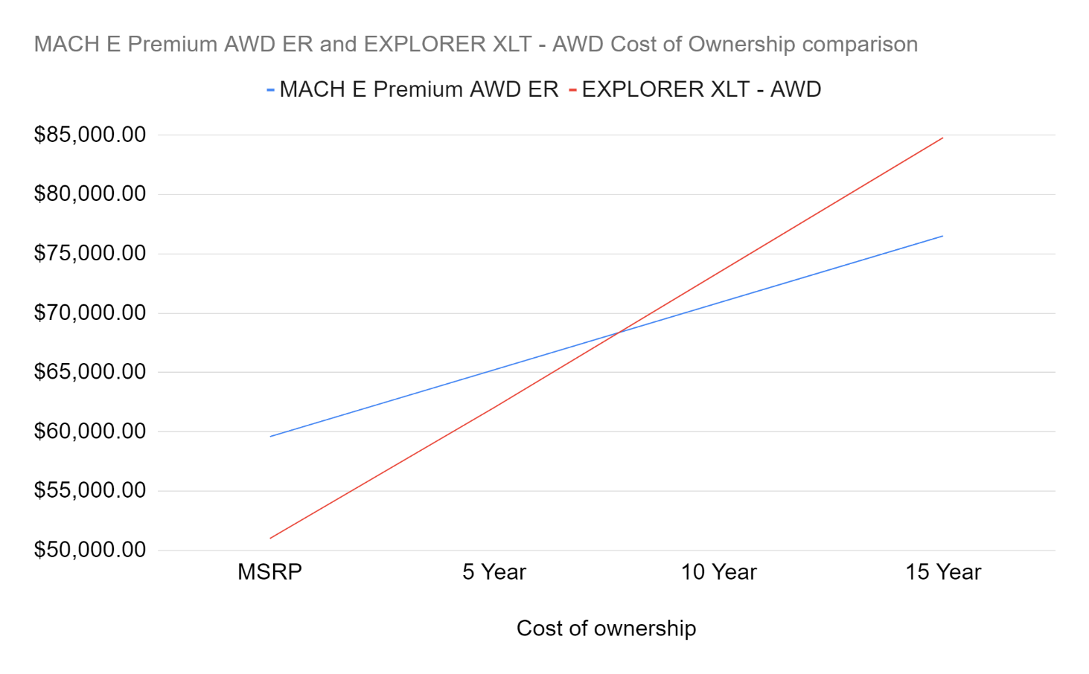
Vehicle cost comparison over time
With these numbers the Mach-E is cheaper to operate at 100,000 miles or 7 years

Slide 12
Why have we not adopted already?
Lack of available cars at a cost-effective price to fulfill the job.
Greater initial cost
Range anxiety
Lack of upfitting ability with emergency lighting and mounting.
Infrastructure previously not able to sustain the charging

Slide 13
But why now?
There is a strong push towards greener transportation and the Westborough Police Department can be that example for other departments in town that electric vehicles can do the job, they can be cheaper to operate, and they can be suitable substitutes for internal combustion engines.
There are tax credits and rebates available to us to defray some of the high up-front costs of the car as well to assist in installing charging infrastructure around town.

Slide 14
Charging needs
Supplied 120V charger
Avg. of 3 miles of range per hour being charged. (24 miles every 8 hours)
Supplied 240V charger
Avg. of 20 miles of range per hour being charged (160 miles every 8 hours)
Ford Connect Charger
Avg. of 28 miles of range per hour being charged (224 miles every 8 hours)
Electrify America
Can be charged from 0% - 80% in 47 minutes depending on output of the charging station.
95hrs to charge from 0 – 100%
14.5hrs to charge from 0- 100%
10hrs to charge from 0 – 100%

Slide 15
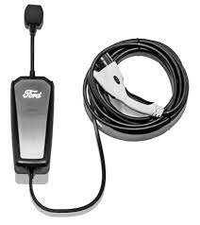
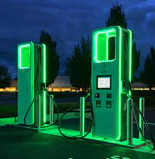
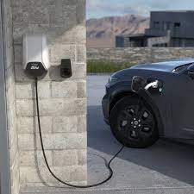
Charging options

Slide 16
Charging systems costs
Ford mobile charger 120V
no installation cost, there are already plugs in the garage to support this charging
Ford mobile charger 240V
240V wall outlet would need to be installed. Estimated $2,000 installation cost
Ford connect charger
240V wall outlet would need to be installed as well as $700 for the cost of the charger for a total of approximately $2700.
DC Fast Chargers
More expensive than charging at home or work between $20 and $30 a session vs $12
Connected to Ford Pass and billed automatically through many national networks
Ford includes free charging up to 250kwh (3 full charges)

Slide 17
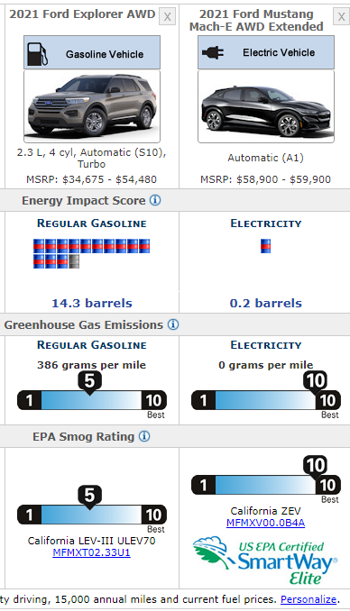
Impact on the Environment
Mach-E emits 0 grams per mile of tailpipe CO2
Ford Explorer emits 386 grams per mile of CO2
Source: Fueleconomy.gov

Slide 18
Total costs vehicle and charging solution
Mustang Mach-E
Vehicle Cost : $67,582.20
Electrical Work: $2,000
Ford Connect Charger: $799
Grand Total: $70,381.20
Optional
Savings potential
Savings and payback could be even greater with discounted electricity rates the Town could access not to mention the possibility of a solar array assisting in charging of this and future electric vehicles.

