Slide 1
Central Massachusetts Regional Planning Commission Presentation
June 29, 2022

Slide 2
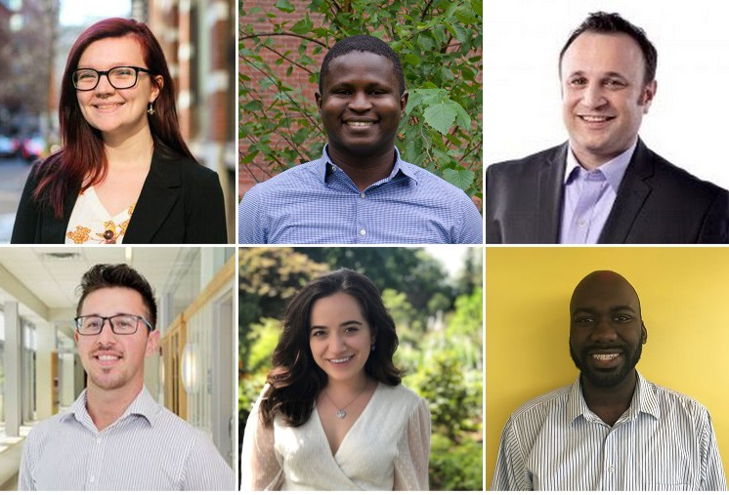
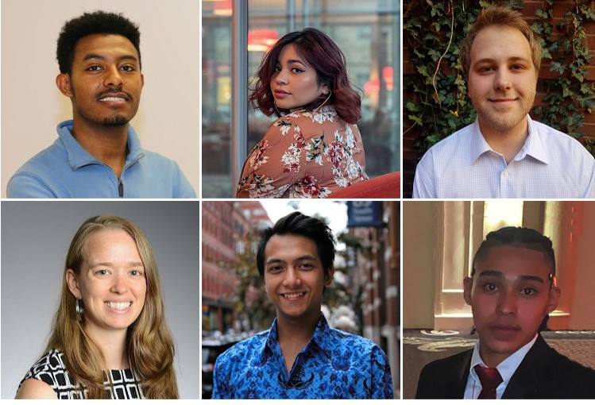
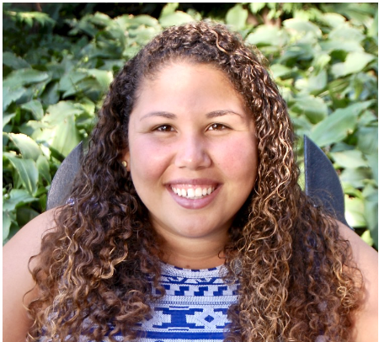
Who is All In Energy?
Nonprofit with mission is to accelerate an inclusive clean energy economy.
Support community-outreach campaigns to bring energy efficiency and affordable renewables to communities with many renters, low-moderate income households, non-English speakers.
Notes:
AIE is a local nonprofit whose mission is twofold. One is to accelerate an inclusive clean energy economy in MA and the other is diversify the clean energy workforce in the state. That means helping everyone get access to energy saving programs, affordable renewable energy, and also empowering minority professionals to get started in the clean energy space.

Slide 3
Mission
Accelerate an inclusive clean energy economy
Notes:
Founded 2 years ago with mission...

Slide 4
All In Energy works at the nexus of two challenges
Massachusetts has nation-leading energy incentive programs
Massachusetts’ clean energy economy is growing
BUT
Renters, non-English speakers and moderate income families are underserved
BUT
Women and people of color are underrepresented
Notes:
We lead the nation with our energy efficiency and renewable energy incentive programs that help residents save energy and money at home and get renewable energy affordably
But more of our state’s efficiency and renewable energy programs’ benefits are going to wealthier communities. The utilities and others rely on mass marketing to educate residents about energy incentives, but education alone is not sufficient to drive statewide action. A report by the Conservation Law Foundation and Applied Economics Clinic indicates that residents in ZIP Codes with lower average incomes, and higher percentages of renters, immigrants and people who speak English “less than well” have not benefited as much as their wealthier, whiter neighbors from the state’s energy-saving programs.
Here in Massachusetts, we have one of the strongest green economies in the country, which has grown 84% since 2010 and employs 110,700 people annually. However, women are underrepresented by 45% in clean energy jobs and people of color report greater difficulty advancing than their white colleagues.
This means our clean energy industry is also missing out on critical talent, at a time when over 60% of MA clean energy companies report difficulty finding qualified talent. The training needed for advancement-track roles in clean energy companies is not reaching our underserved communities. Companies with greater diversity are more innovative and more successful - and we need innovative, successful companies to rapidly transition to a clean energy economy.
Furthermore, the economic and societal transformation needed to avoid societal collapse brought on by climate change cannot happen without all communities becoming efficient and sustainable. We need to accelerate an inclusive clean energy economy that does not exacerbate societal inequities, but instead includes and benefits all communities.

Slide 5
Our approach
We bring energy
efficiency and
renewable energy
to underserved
communities
We bring diverse talent to careers in the clean energy industry
Notes:
Before we talk about how, let’s look at some of the barriers to success

Slide 6
Challenges for underserved groups (renters, non-english speakers, low-to-moderate income)
Awaress: Mass marketing, targeted marketing are insufficient
Trust: The messenger is as important as the message
Access: One size does not fit all
Time: Barrier to action must be very low

Slide 7
Some strategies to overcome barriers
Involve cities and/or local community based organizations
Meet people where they are
Think about the whole customer journey. Building awareness and interest is only half the battle
Use data to target resources to where they are needed most

Slide 8
Barriers: Renters
Renters
Pay into Mass Save monthly, but don’t know they can use it
Tenant/Landlord incentives for action are misaligned
Little incentive to serve renters (lower insulation probability)

Slide 9
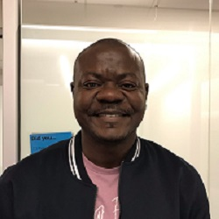
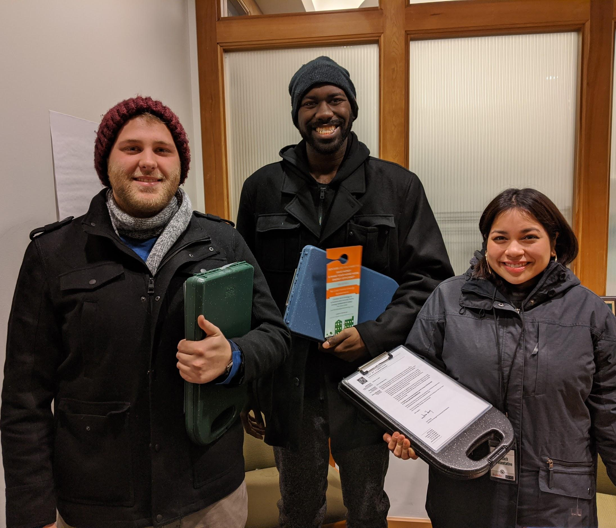
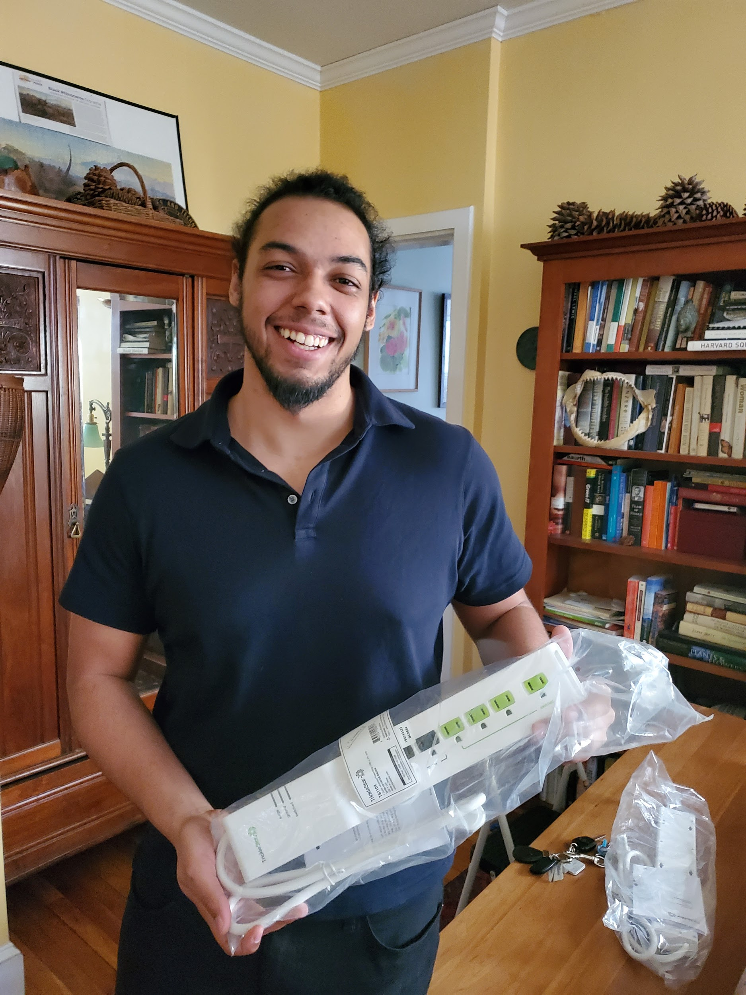
Renters: Cambridge
Innovations:
Results:
Pre-COVID: 191 Renters Served in 6 months
COVID era: 100+ renters units weatherized through landlords
Rental Property Energy Advisor
Canvassing Team
Landlord letter with 100% incentive

Slide 10
Barriers: Spanish Speakers
Spanish speakers
Most outreach is in English
Full process not in Spanish (e.g. Spanish language contracts)
Negative experiences lead to distrust, disenfranchisement

Slide 11
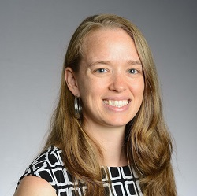
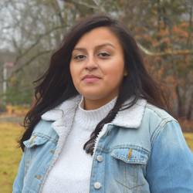
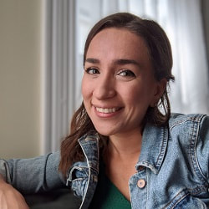
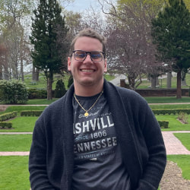
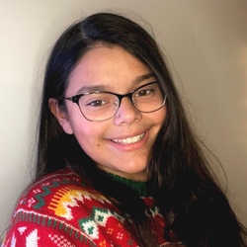
Spanish Speakers: Merrimack Valley
Innovations:
Spanish-speaking staff at all levels to provide outreach support
Work with vendors to create Spanish language pathways
City channels + Spanish-language channels
Notes:
Lawrence

Slide 12
Barriers: Low-to-Moderate Income
Low-to-moderate income families
Access to, or desire to take on, loans
More likely to be behind on utility bills, so immediate savings less meaningful
Lack time to learn about, enroll in energy programs

Slide 13
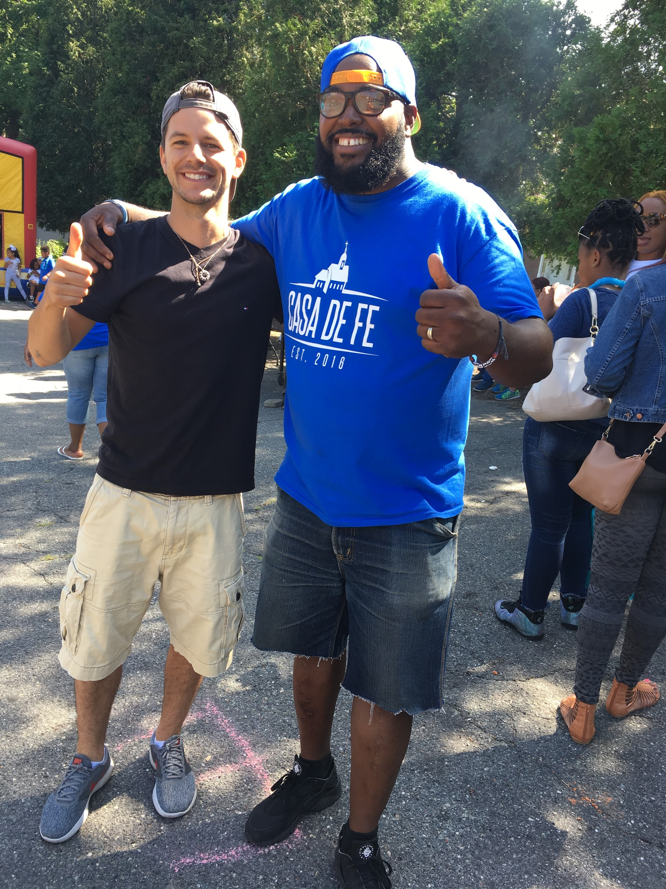
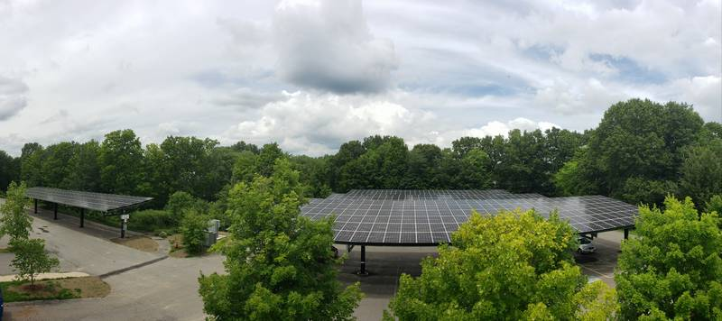
Expanding Access for Low Income Residents
Community Surveys to understand needs
Low Income Community Solar offering
Community Outreach Partners
Lots of learning!
Notes:
Lawrence

Slide 14
Contact for more information
Gabe Shapiro
Co-Founder & Co-Executive Director
Gabe@allinenergy.org
(781) 656-5359
allinenergy.org

