Slide 1





Municipal Microgrids Revisited -
Resilience and Beyond
How to procure resilient electric power for community lifelines
with an Energy as a Service (EaaS) financing model

Slide 2
Agenda
Introductions
Microgrids 101
MassCEC CLEAR Program Results
Energy as a Service (EaaS)
Benefits, Challenges, Solutions
Funding Opportunities
Microgrid projects
Q&A

Slide 3

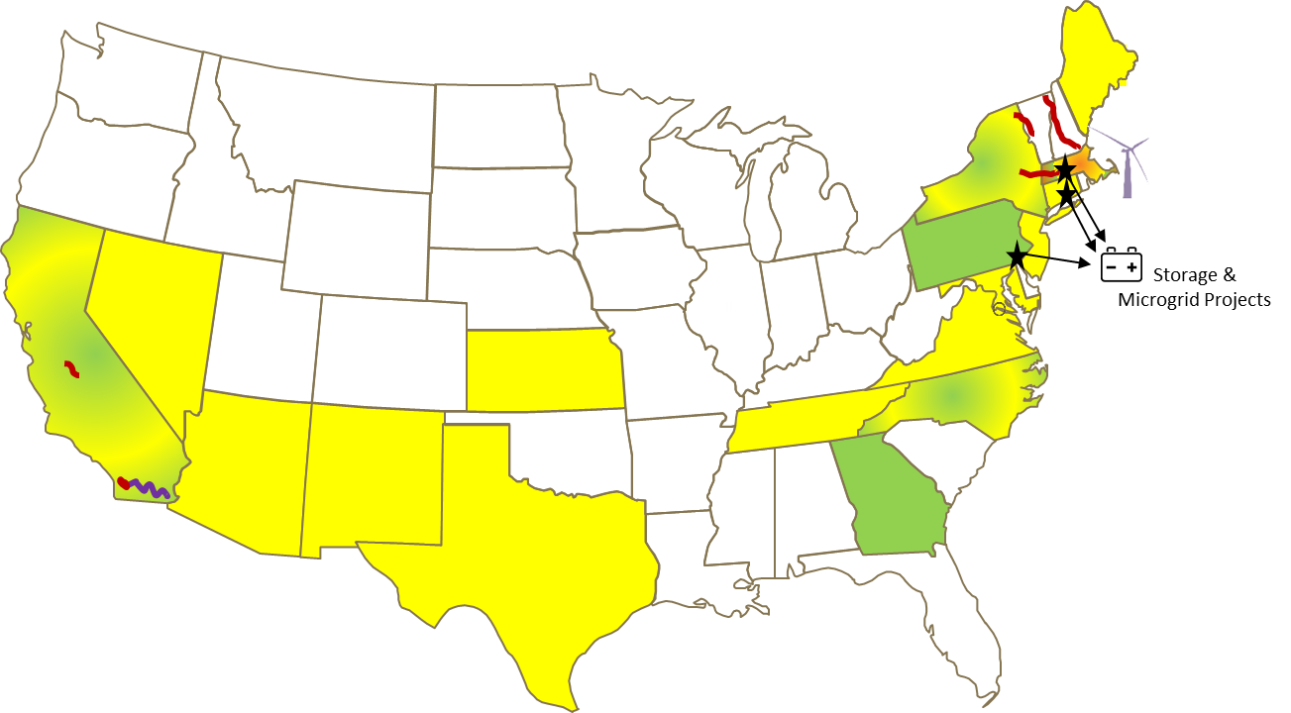



Citizens Energy Corporation
A non-profit energy company, HQ in Boston, MA
Mission is to make life’s basic necessities more affordable to those in need
Small in size, but able to offer fully integrated development, construction and financing process with the flexibility to meet the needs of partners and customers
Channeled over $600 million of dividends from business ventures to support charitable programs.
$550
MILLION
TOTAL PROJECT VALUE
207
MEGAWATTS
TOTAL CAPACITY
47
PROJECTS
OWNED & OPERATED
Business | Strategy | Current Portfolio
 | Partner with utilities to develop and finance high-voltage transmission assets | Sunrise Powerlink & Sycamore-Peñasquitos Tx lines ( SDG&E)
 | Develop, construct, finance, own, and operate distributed utility-scale solar PV projects | 44 projects, 200 MW. Joe-4-Sun Low Income Community Solar (LICS) Program
 | Develop, construct, finance, own and operate storage & microgrids | 2 BESS projects – 30 MWh 1 microgrid project

Slide 4

Schneider Electric
Key figures for 2020
650k
service providers
& partners
Over 300 microgrid projects delivered globally
Over 900 electrification projects delivered globally
#2 in Microgrid control technology by
Navigant Research (2020)
Pioneer in innovative digital and IoT solutions for MV equipment & SF6 free switchgear.
5%
We partner in everything we do
45k+
of revenues
devoted to R&D
system integrators & developers
3k+
€25.2B
2020 revenues
electricity
companies
Home
Building
Industry
Data Center
Infrastructure
Cities
Microgrid
Deep Domain Expertise
41%
of revenues in new economies
128,500+
Employees in over 100 countries
Taking Sustainability to the next level

Slide 5
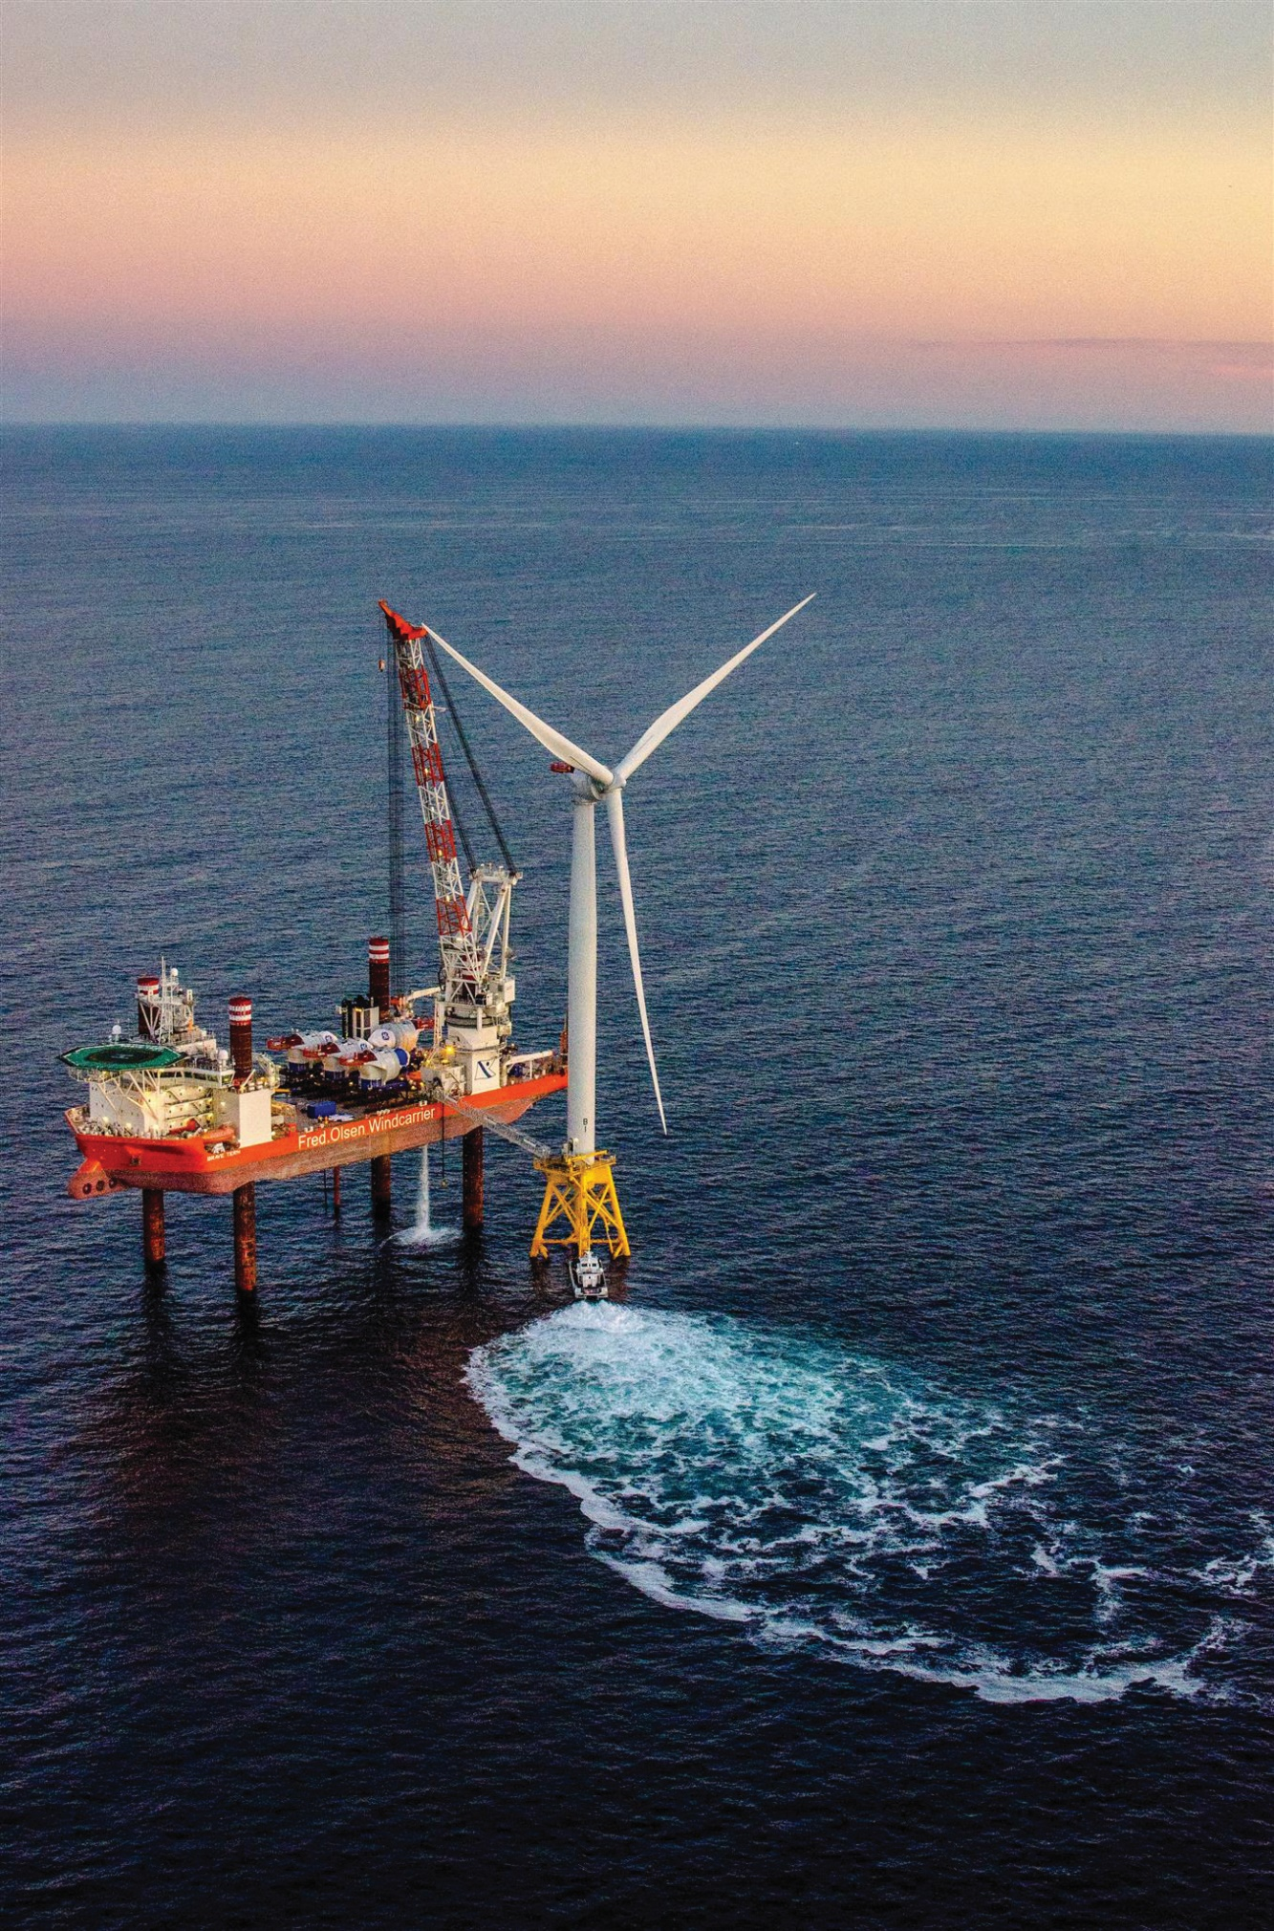
GZA
We are excited to work with you.
Every day, GZA’s professionals build on a legacy of trust through their personal commitment to excellence.
Because there is a free flow of information and support amongst our employees and offices that operate as One Company, we can provide every client with access to our extensive knowledge and experience base regardless of project location.
Clients know - expect - that we will deliver expert solutions that help them succeed regardless of the size or complexity of their challenges. It is why we are known for excellence, built on trust.
57
SERVICES
YEARS
Geotechnical
Environmental
Ecological
Water
Construction
Management
STRONG
1964-2021
30
700+
STAFF
OFFICES
Engineers
Scientists
Employee-
Owned

Slide 6






GZA – Core Services
Supporting
Structures
Compliance and Improve the
Environment
Working
with Natural Resources
Wherever Water Touches
Planning, Prioritizing, and Executing
www.gza.com

Slide 7
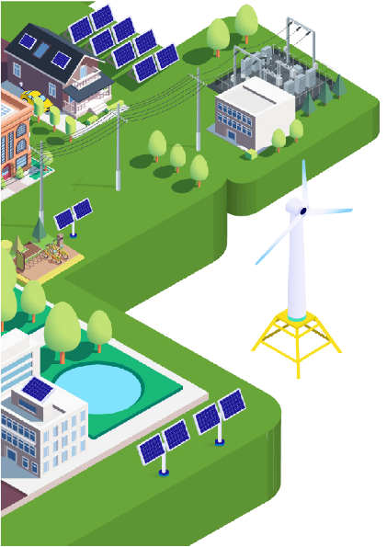
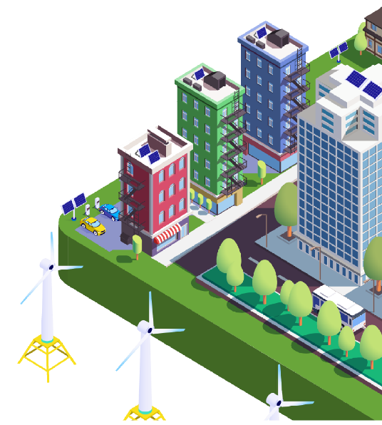
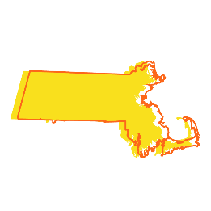


Over the last decade, MassCEC’s clean energy programs and investments have awarded over $360M and attracted over $2B in private and federal capital.
SINCE 2010
MASSCEC HAS:
Awarded $128M for technology innovation and company growth
Enabled an 86% increase in clean energy jobs
Awarded over 46,000
clean energy projects
Supported over
900 companies
MassCEC has Reduced Carbon Emissions Equivalent to:
Massachusetts’ Clean Energy Industry is Robust and Growing
MassCEC has Trained Tomorrow’s Clean Energy Workforce
261,000 homes powered for a year through current investment companies
52,000 jobs added since 2010, for a total of 111,000+ workers in 2019
4,200+ college and
vocational internships
467 employers offering internship opportunities
4.5M trees planted through clean energy projects
$14B+ contributed to the Gross State Product in 2018
3,600
certificate trainees
61% of interns are women or minorities

Slide 8
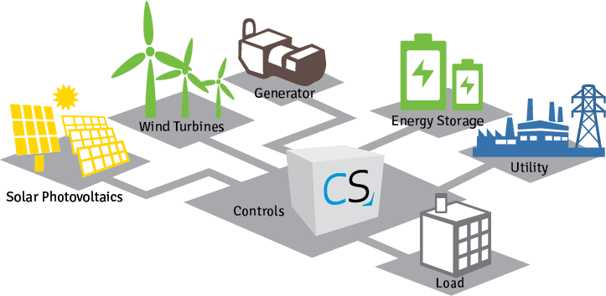
Microgrid 101
What is a microgrid?
An integrated energy system consisting of interconnected loads and distributed energy resources…
…which as an integrated system can be controlled as a single entity and operate in parallel with the grid or in an intentional islanded mode.

Slide 9
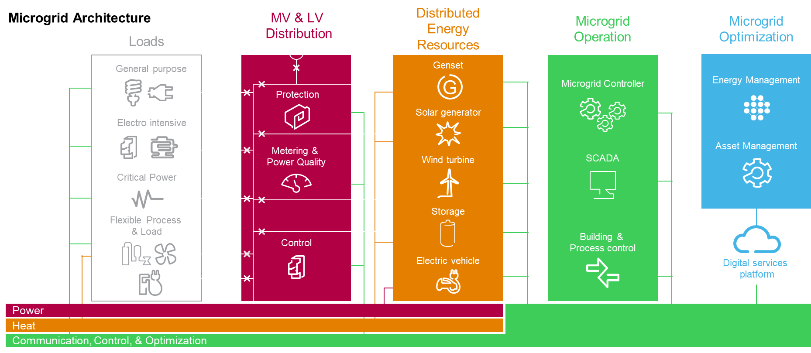
Microgrid 101
What are the major parts of microgrids?

Slide 10
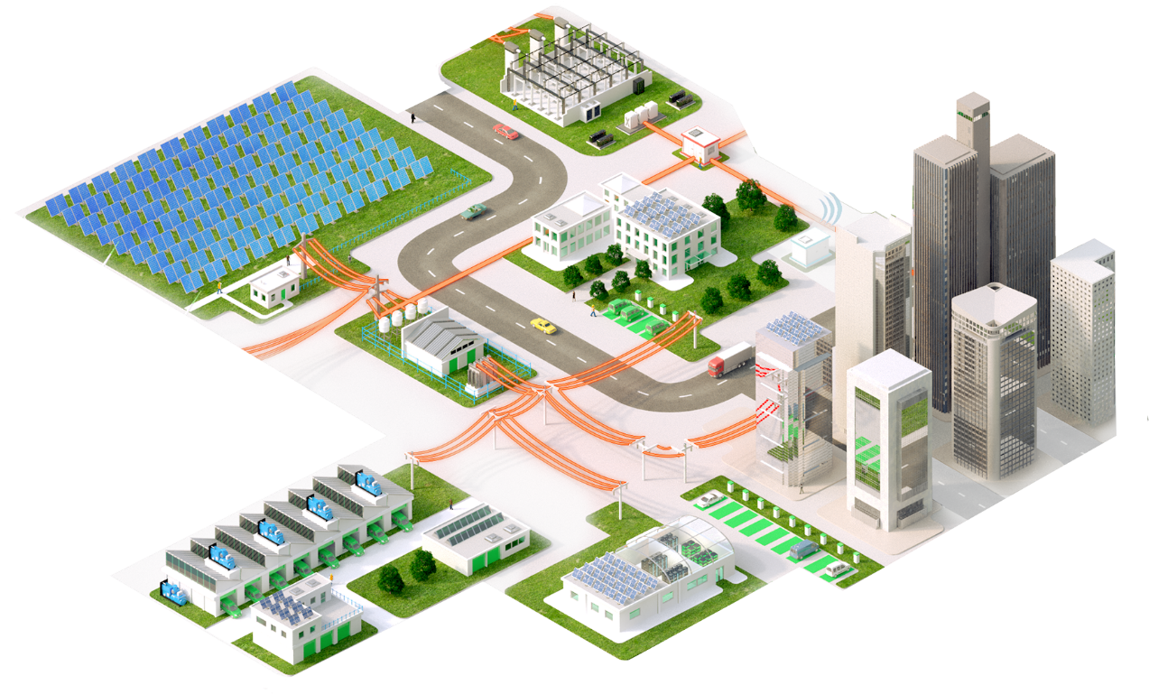
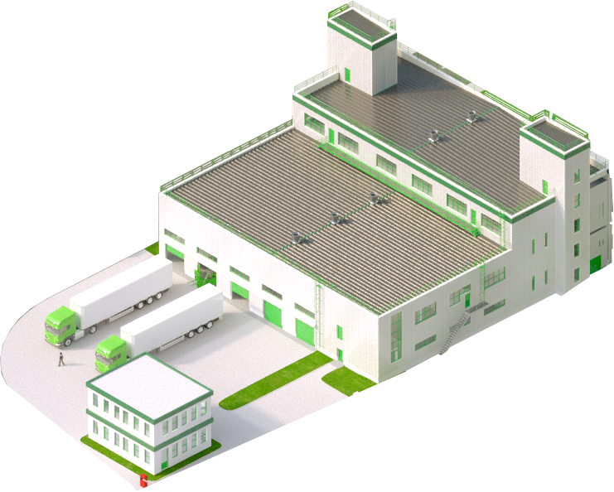
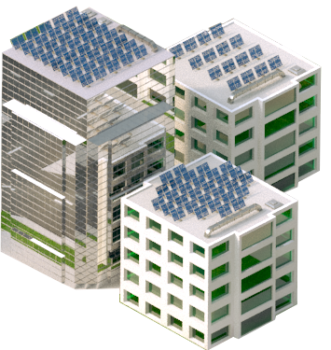

Microgrid 101
How scalable are microgrid solutions?
There is a microgrid for everyone

Slide 11
Microgrid 101
What kinds of microgrids are there?
  On-site renewables, energy storage, and other power generation facilities utilized in parallel with the utility grid largely for economic purposes
  Microgrid will generate energy from local sources and in the case of a grid outage or other event adding resilience to the site
  Microgrid will generate energy from local source(s) as no utility grid is available
Grid-tied
Island-able
Off-grid

Slide 12

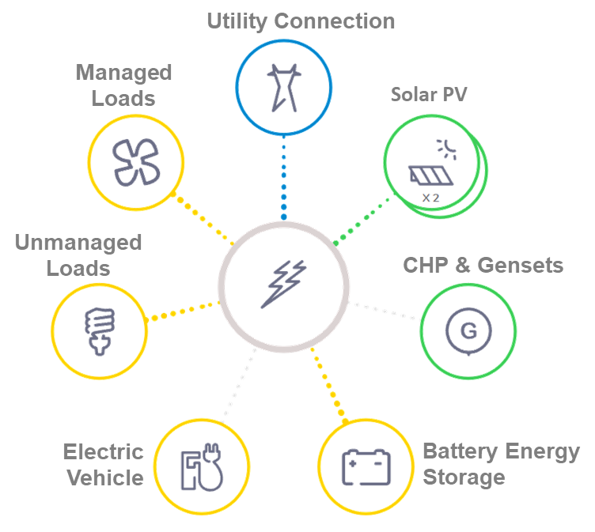


Microgrid 101
What are the benefits of Microgrids?
Solving for Integrated Outcomes
Historically passive consumers are thinking about energy in new ways
  Cost
  Lower / More Predictable Energy Costs
  Energy / Fuel Source Arbitrage
  Flexibility drives savings / incremental revenue
  Resilience
  Serve loads during times of grid stability
  Oasis for employees / customers – shelter in place
  Protect power sensitive / critical assets from poor power quality
  Sustainability
  Reduce carbon footprint
  Improve brand image
  Attract / Service carbon sensitive customers

Slide 13

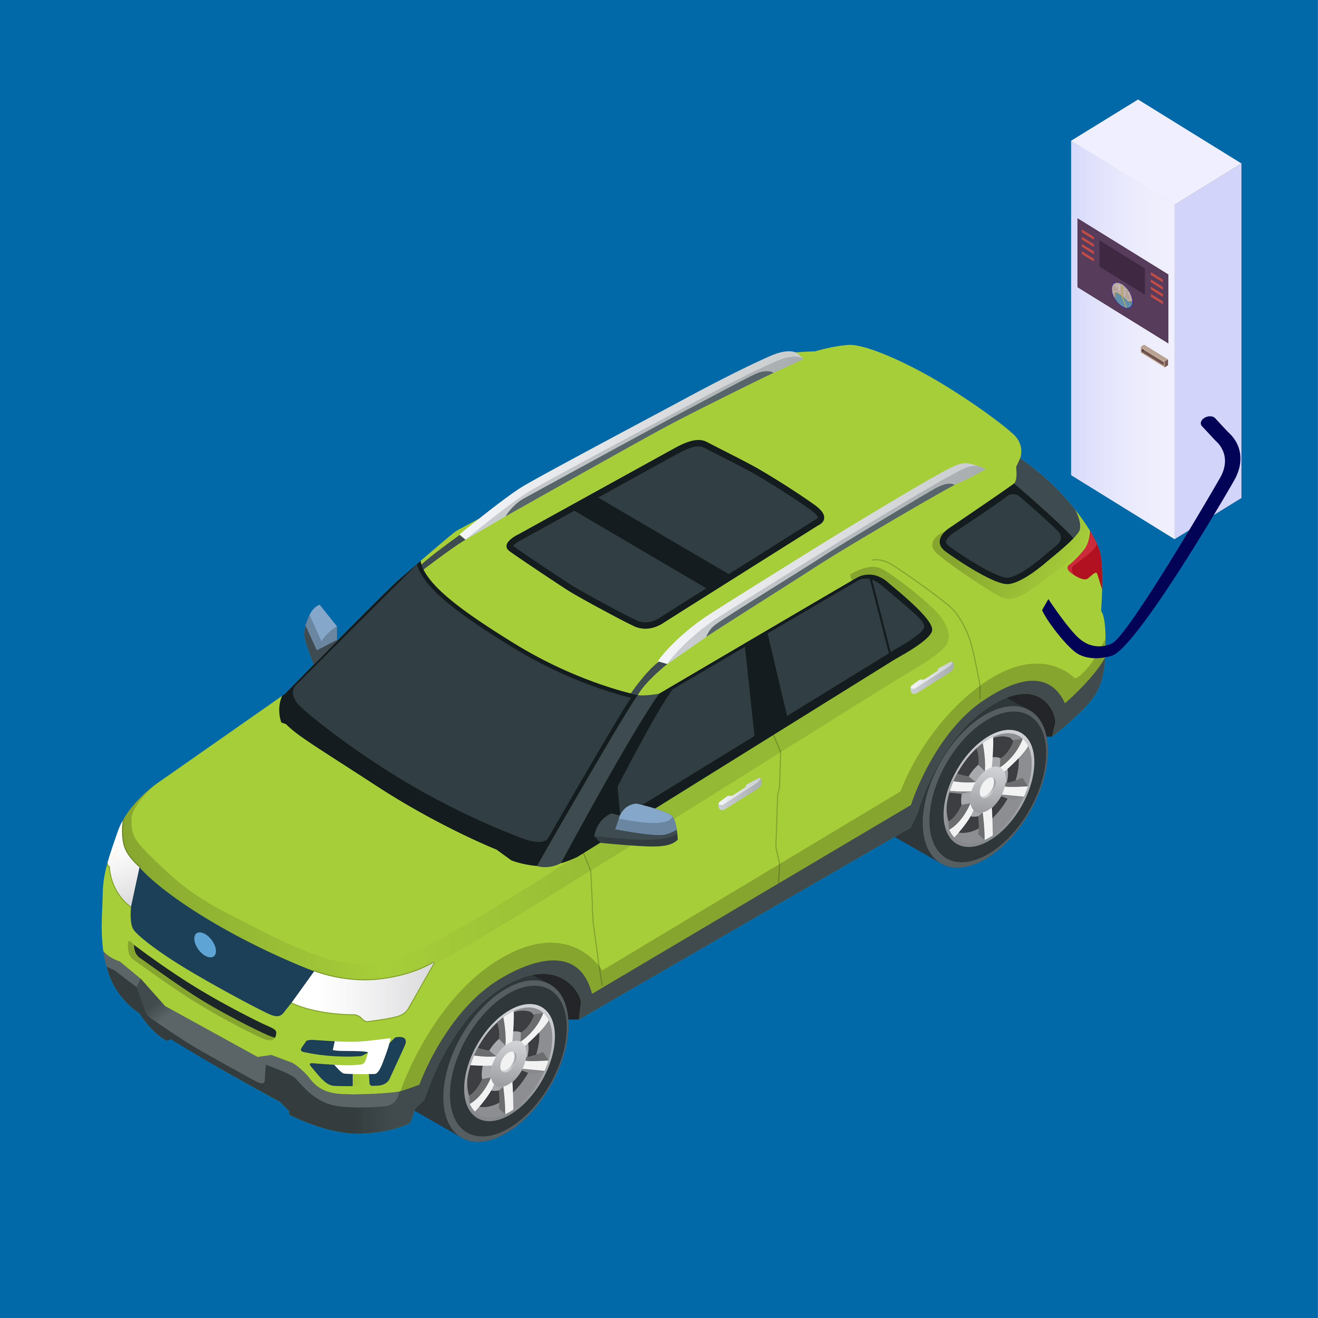
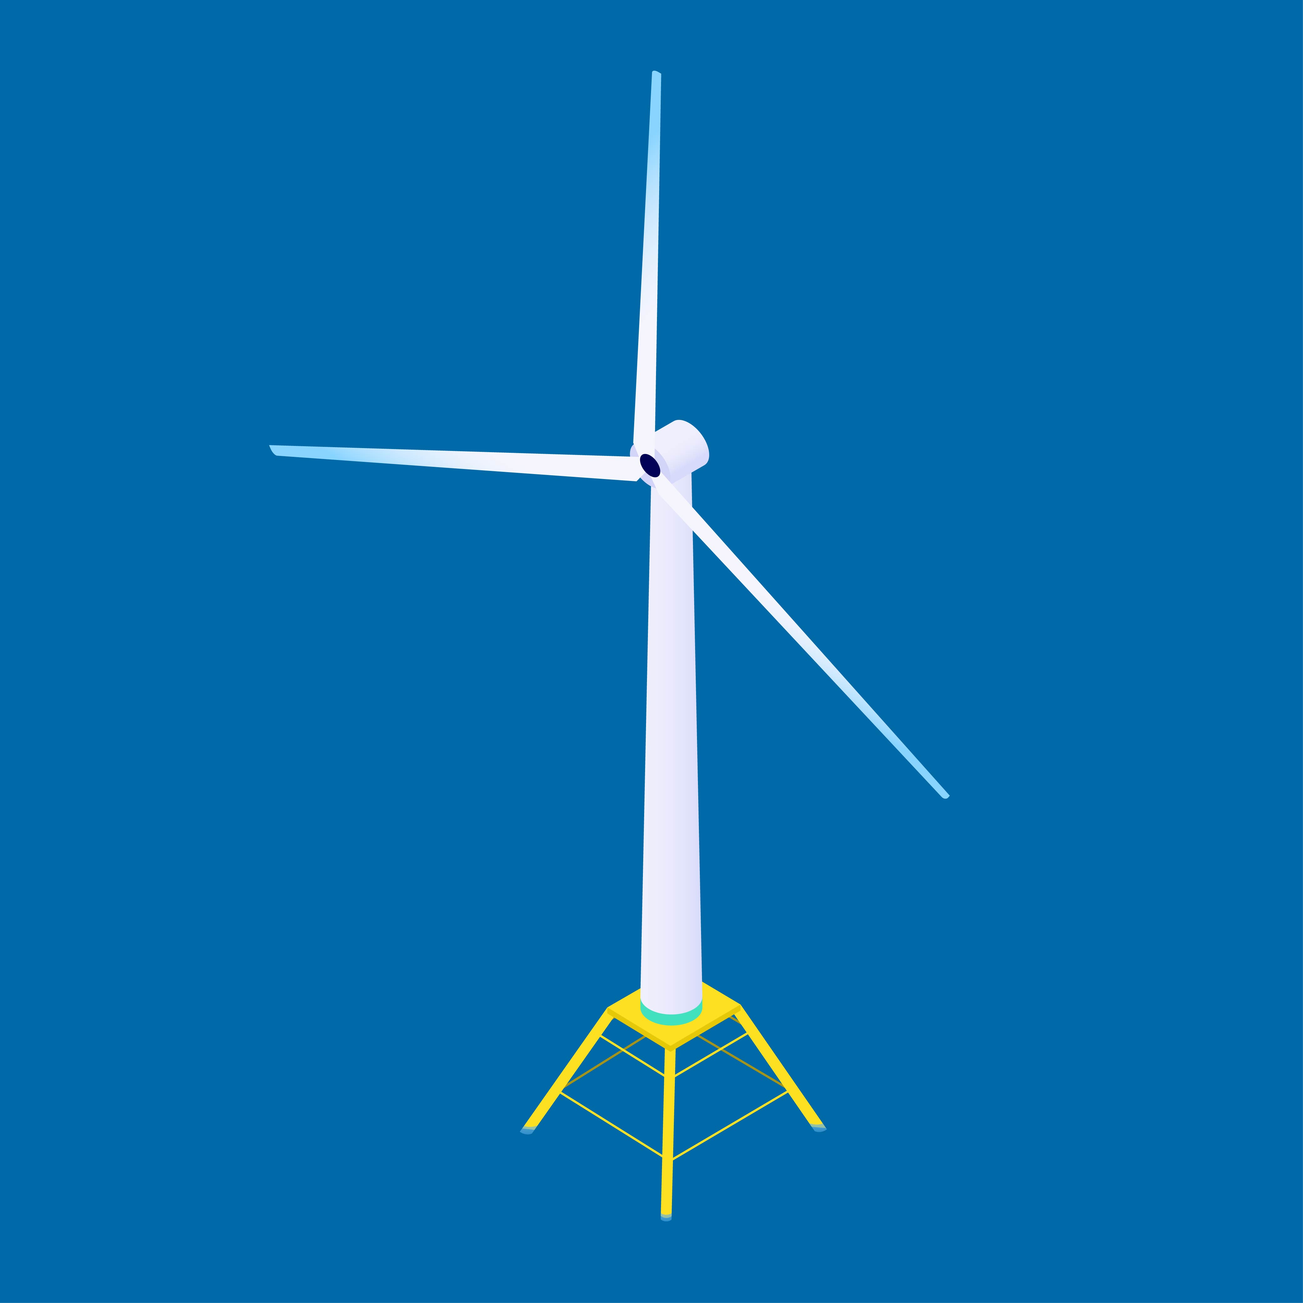
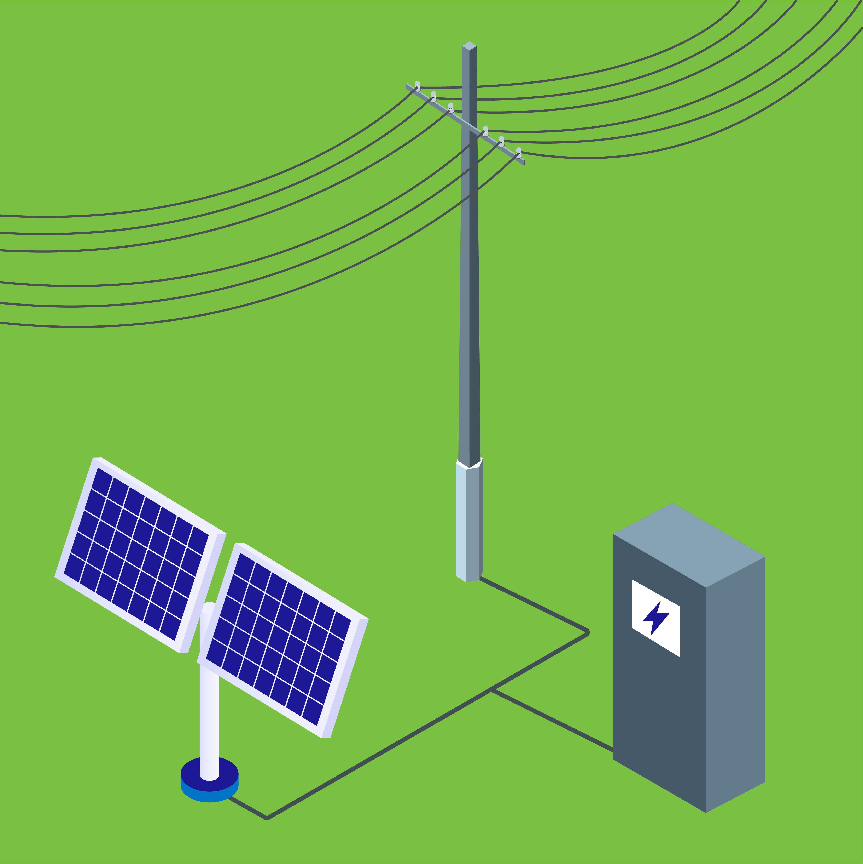
MassCEC Focus Areas
High Performance Buildings
Clean Transportation
Offshore Wind
Net Zero Grid
Investments – Technology Development – Workforce

Slide 14

The Need for Municipal Resilience
To achieve decarbonization, transportation and heating will need to be electrified
This combination makes electric resilience increasingly critical for communities
Climate change will lead to greater frequency and severity of weather events
Notes:
Challenging market segment to serve—not a large MUSH facility or private C&I building and also not a private residence.

Slide 15
Program Scope
Clean Energy and Resilience (CLEAR) Program sought to advance resilience system designs for critical facilities
MassCEC awarded funding to consultants for:
  Microgrid feasibility studies
  Nine facilities, campuses, or communities in Boston, Framingham, Cohasset, West Tisbury, Natick, and Bedford
  A Resiliency Toolkit that communities can use to identify resiliency needs and gather preliminary information
  A Resiliency Certification to certify sites as resilient to outages
Notes:
MassCEC awarded funding to three consultants: GE Energy Consulting, The RAND Corporation, and Willdan

Slide 16
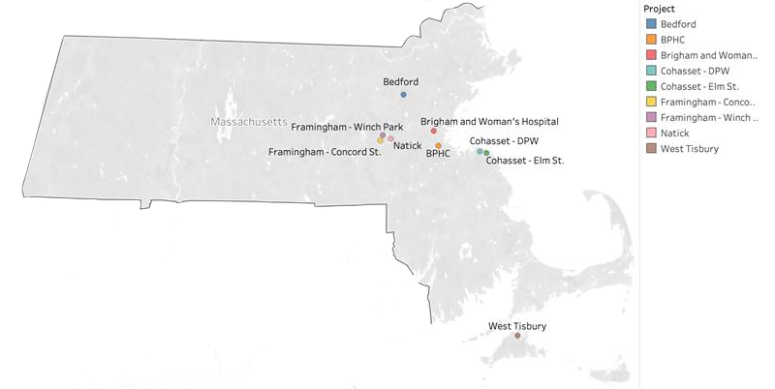
Map of CLEAR Projects

Slide 17
Analytical Challenges
Historical data will fail to predict future "typical" outages as climate change causes atypical events to occur more frequently.
Established parameters, accepted definitions, and benefits of resilience remain undefined.
Predicting how typical load shapes will adapt to unanticipated demands and system constraints is challenging.
Notes:
To determine how loads will adapt to unanticipated demands, it is necessary to measure the load characteristics of critical infrastructure during outages
Notably, municipal leaders were unwilling to receive a “resilience certification’ to avoid deprioritizing their facilities during an outage

Slide 18



Design Considerations
Many of the sites selected already included legacy diesel generators.
CLEAR consultants explored how best to maximize existing resources while adding solar power and battery storage.
Solar power allows diesel generators to support a system during an outage for longer, and existing diesel generators can diminish the size of the required battery.

Slide 19
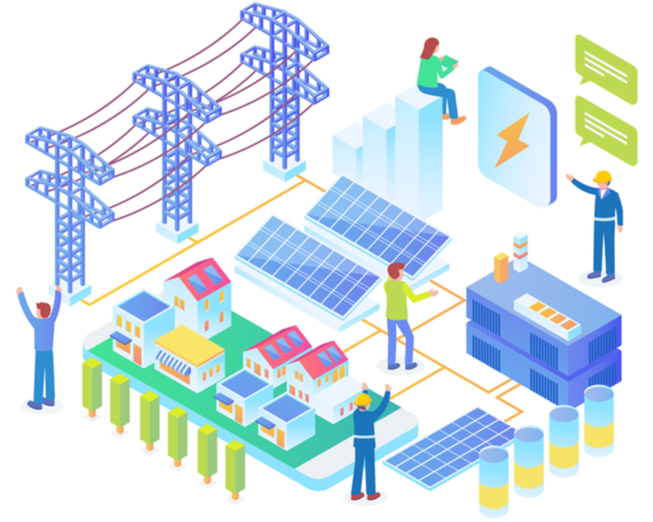

Operational Insights
Pathways to implementation and procurement are crucial to successfully executing projects at the municipal level.
Investments should be sized and wired to support the majority of a facility’s energy needs.
Vehicle-to-Grid (V2G) solutions may be a financially viable way to electrify and provide resiliency
Notes:
In practice, attempting to reduce costs by supporting only those loads which are critical in an emergency is challenging due to uncertain foreknowledge and rewiring requirements.

Slide 20



Financial Considerations
Rooftop and canopy solar tend to make sound investments for municipalities, especially when using power purchase agreements
Energy storage can diversify revenues and prove a good investment for towns and cities.
However, if storage is used for resilience purposes and not purely to maximize profit, system costs will increase.

Slide 21


Financial Considerations (cont'd)
Electric distribution equipment necessary to provide resilience is costly and can cause the costs to outweigh financial benefits.
An Energy-as-a-Service (EaaS) model can spread high up-front capital costs out over time and significantly reduce the challenges of ownership and operation. Grant support from state or federal agencies can also be crucial for municipalities to implement projects.
Notes:
Communities must have clear goals for the project and decide how highly to prioritize resilience and financial payback.

Slide 22
Alternatives & Complements to Microgrids
Right-sizing diesel backup generators
Undergrounding wires
Improving energy efficiency
Working with Power Options to procure storage
Building redundancy into facilities

Slide 23
Resiliency Toolkit
MassCEC developed a Resiliency Toolkit that communities interested in resiliency projects can use to conduct their own preliminary analysis before hiring a consultant.
A step-by-step guide including:
  Critical load selection
  Independent resource screening
  Preliminary pricing information
  Instructions to find data from utility websites and billing platforms
See this presentation for detailed toolkit instructions with images

Slide 24
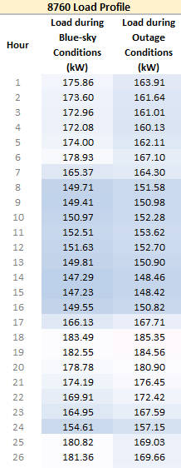
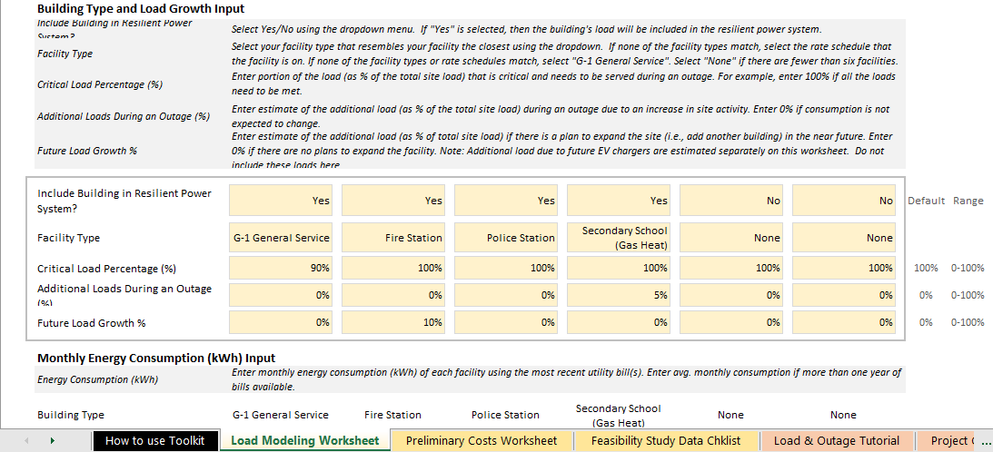
Resiliency Toolkit Example
Example Load Modeling Output
Example Load Modeling Input
Notes:
*Images taken from Example Resiliency Toolkit available on the MassCEC CLEAR website: https://www.masscec.com/clean-energy-and-resiliency-clear

Slide 25
Conclusion
Resiliency is a critical component to reaching net zero emissions due to its secondary mitigation effects that establish a safe and secure path to electrification.
The marketplace as currently constructed is not optimized to provide municipal resilience, but a statewide planning strategy could support greater resilience at the community level.
CLEAR aimed to identify scalable and replicable microgrid projects; however, this remains challenging due to site specific constraints and procurement challenges.

Slide 26
Energy As A Service (EaaS)– More Than Just Financing
De-risking microgrid projects with no capital outlay
CAPEX
Energy as a Service
Burden on balance sheet for costly energy infrastructure upgrades
Ownership risk associated with new energy technology (microgrids) performing as anticipated
O&M staffing skill needed to support this more sophisticated energy system
Unpredictable year-over-year O&M budgets and exposure to long term energy cost increases
Regulatory risks related to energy and sustainability
Customer capital freed up for core business needs and priorities
Protected from financial, regulatory and technical risks
Industry-leading experts manage system operations and maintenance
Contractually committed, long-term, predictable OPEX
Reliable system performance for efficiency and sustainability

Slide 27
EaaS – What Would the Structure Look Like?
Structure works like a Solar Power Purchase Agreement (PPA), but it doesn’t need to be based on energy production or usage.
Energy Solution
Customer Benefits
Cost savings & Predictability
Risk Mitigation
Resilience & Reliability
Sustainability & Efficiency
Infrastructure Upgrades
Citizens Energy Corporation works with Technology & EPC Partners to develop, construct, own & operate the project.
Customer pays monthly fee to cover capital and operating costs
Cost
Resilience
Sustainability
Energy Services Agreement

Slide 28
Challenges and Hurdles
Massachusetts municipalities across the state identify resilient power supply as a top concern due to more frequent extreme weather and power outages in Municipal Vulnerability Preparedness (MVP) Plans
A microgrid needs to be more resilient than the grid to operate during outages
Very few municipalities have experience purchasing microgrids
It’s not easy becoming a micro-utility for your most critical community lifelines
Municipal capital funding for installing and operating microgrids is limited
Municipal grant writing capacity is limited, and grant awards are very competitive
Consensus building and political will are essential to be successful.

Slide 29
Solving Challenges for Community Microgrids
Studies continue to show the main barriers for community microgrids.
Strategic Alliance of Schneider Electric, GZA and Citizens Energy Corporation addresses each of the major concerns:
 | Community Concerns | Strategic Alliance Approach
P | Limited Community Engagement | Focus on community engagement early Initiate discussion w/ local officials & stakeholders
P | Non-Renewable Generation Technologies | Focus on renewable energy as much as possible
P | Financing Challenges | Energy-As-A-Service (no upfront costs) Grant application assistance
P | Lack of Metrics for Valuing Resilience | Benefit Cost Analysis Collaboratively calculate specific Value of Resiliency

Slide 30
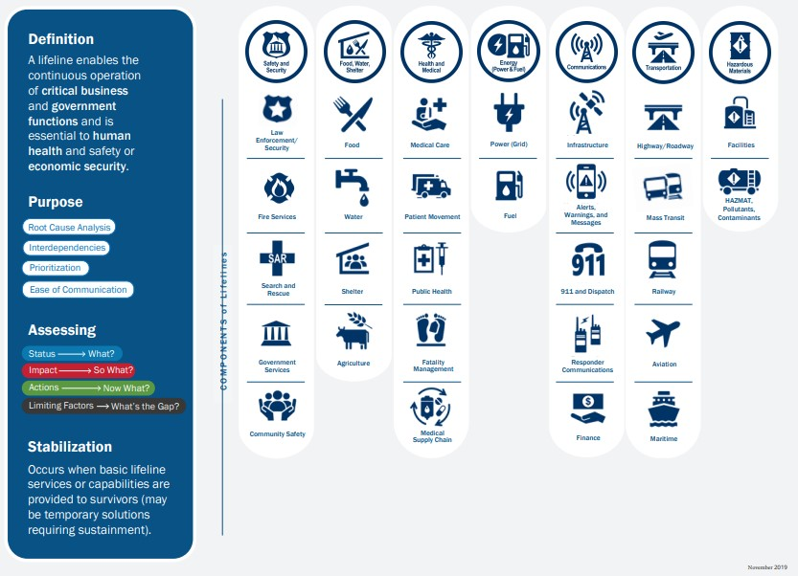
Community Lifelines – Department of Homeland Security

Slide 31
Benefit Cost Analysis (BCA) and Value of Resiliency
Federal funding source (Ex. FEMA BRIC Grant) establishes the methodology for the value and BCA of the resilient power.
Having the microgrid project identified as a priority in a municipal plan ( Ex. Hazard Mitigation or MVP Plan) is a pre-requisite.
FEMA and other federal agencies have not yet established standard BCA approaches for extreme heat-related (or extreme cold) risk reduction projects.
The New York City Mayor’s Office of Resiliency Climate Resiliency Design Guidelines (CRDG) for heat and other climate-related hazards include average unit benefits.
CRDG unit benefits are based on energy savings, increased air quality, improved quality of life/health, and higher real estate and retail sale values, and are tied to NYC Discount Rates and current NYC electric and gas rates of $0.27/kWh and $0.21/Therm, respectively. These unit benefits can be easily adjusted to the Federal Discount Rate and local utility rates to estimate unit project benefits for efficient air conditioning projects.

Slide 32
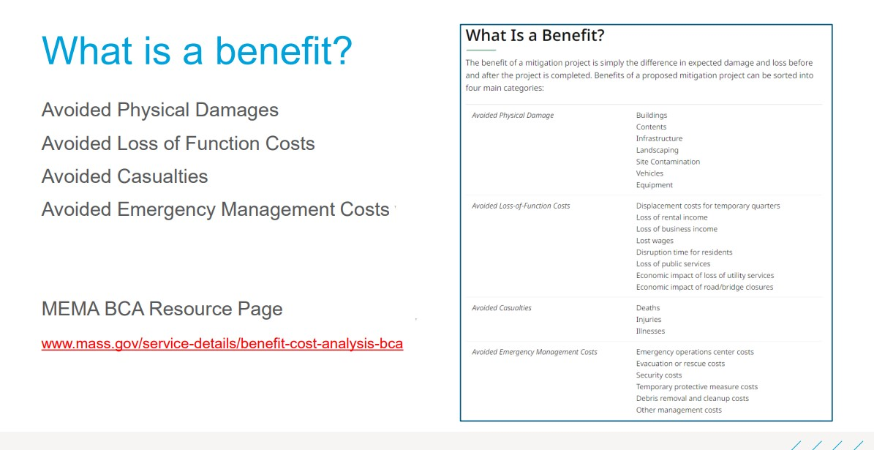
BCA – MA Emergency Management Agency

Slide 33







Technical Assistance and Funding Opportunities
MA Green Communities Program
MA Clean Energy Center (MACEC)
MA Municipal Vulnerability Preparedness (MVP) program
American Rescue Plan Act (ARPA)
FEMA Building Resilient Infrastructure and Communities (BRIC) Program
FEMA Hazard Mitigation Grant Program
DOE – New IIJA - Prevent Outages and Grid Resilience $2.5B

Slide 34
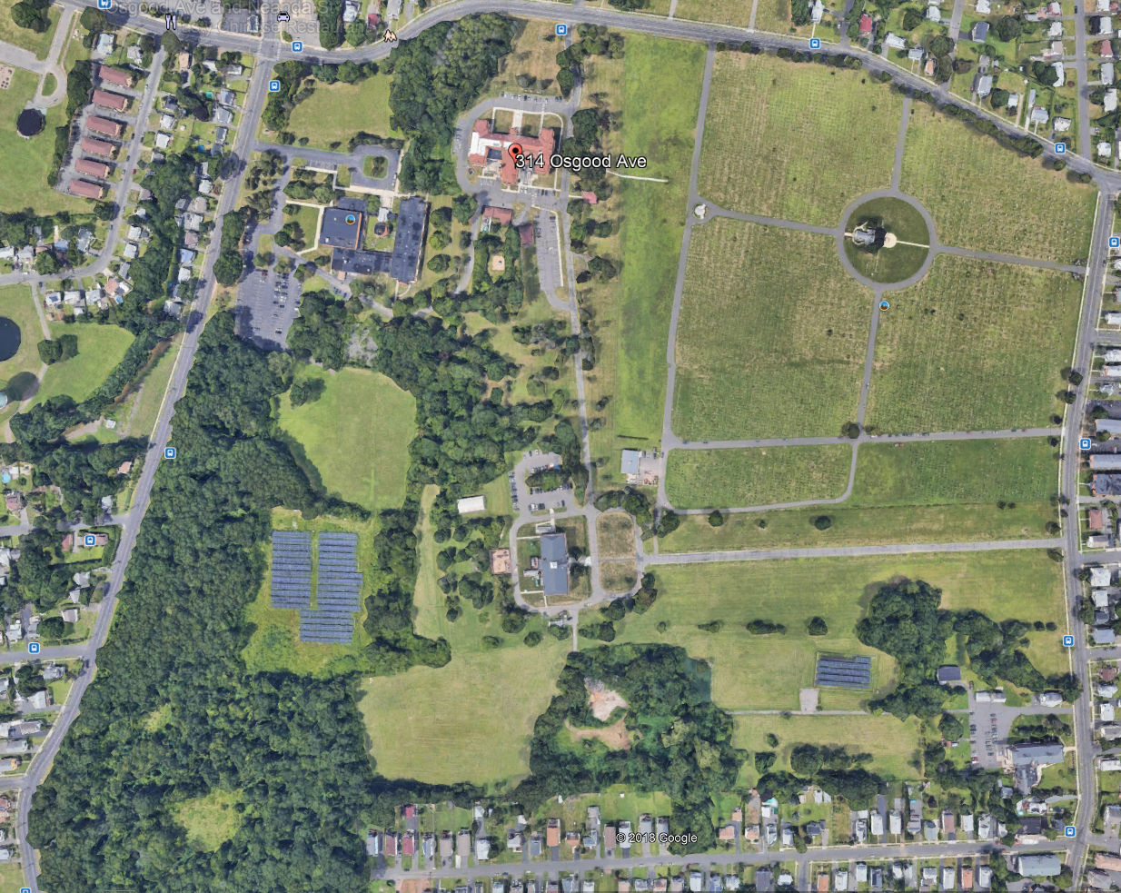
Daughters of Mary Microgrid
Location: New Britain, Connecticut
Assets: 1 MW solar, 1.3 MWh storage, 500 kW NG gen
Year Built: 2021
Interconnection: 4.8kV
PPA & ESA: Daughters of Mary
Description: KOREPower Lithium Ion
Use Case: Resiliency and electricity cost savings
New low voltage gear and microgrid controls
New Natural Gas Generator
Existing Solar PV Arrays - connected for island mode
New solar arrays

Slide 35
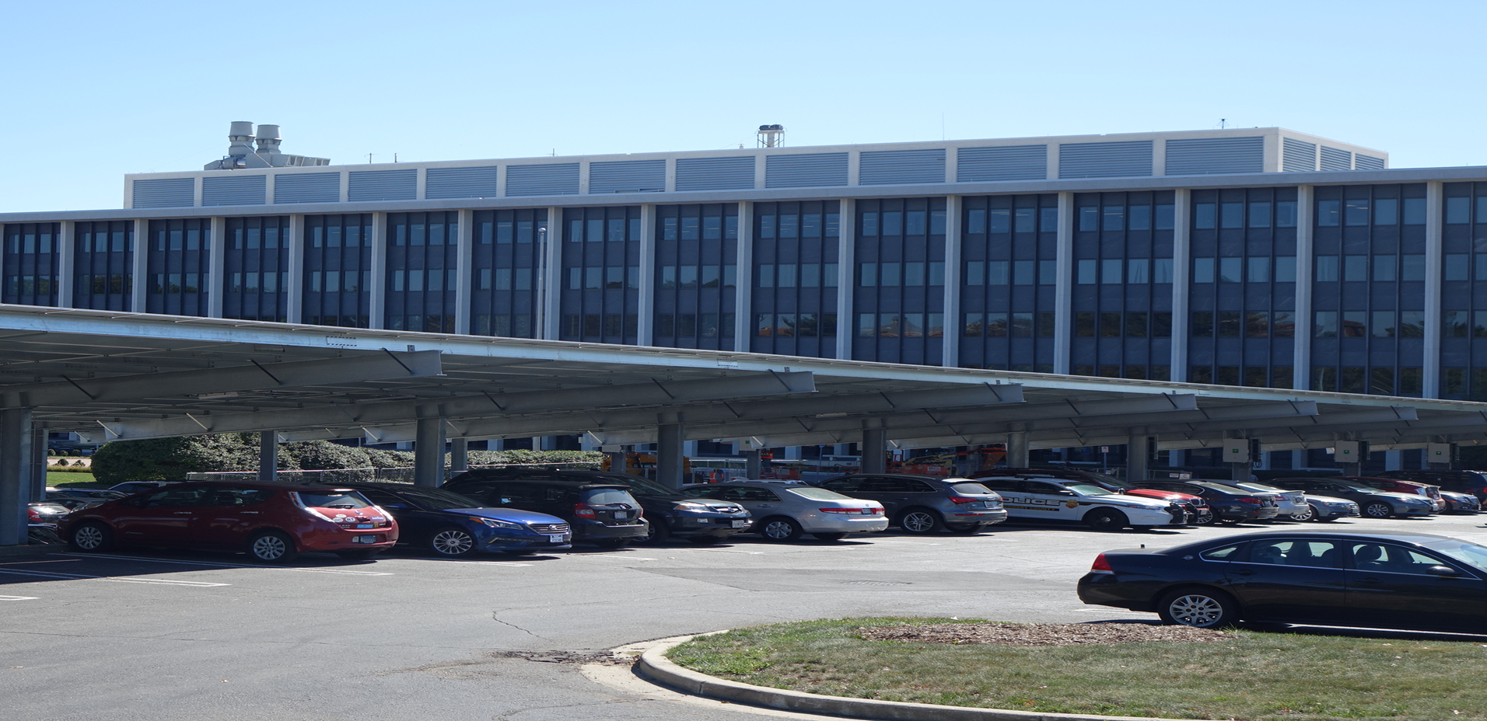




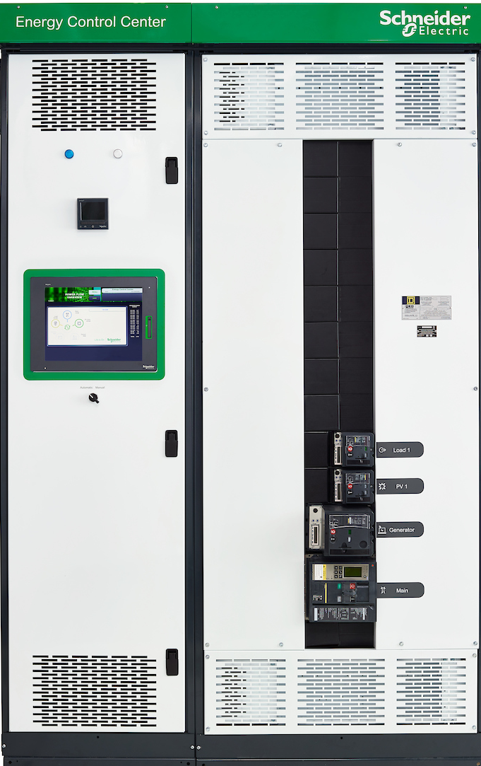
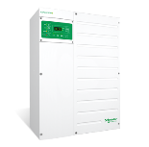
Montgomery County Maryland
Innovative Resiliency solution for Public Facilities
Customer Challenge
Aging infrastructure, aggressive resiliency and sustainability goals.
The Solution
Microgrid-as-a-Service project at Duke Energy Renewables to improve reliable power supply for Montgomery County Public Safety HQ & Correction Facility.
Customer Benefits
Secure resiliency of public services
Infrastructure upgrade – reduced capex
Protect critical operations during power outage
Mitigate risk of escalating energy prices
Reduce greenhouse gas and other emissions
The Results: Life is On with...
No-money down microgrid providing greater operational reliability and ensure resiliency during severe weather and other incidents.
One of the first “No-Money Down” microgrids helping protecting Washington D.C. area citizens
First US GCI PEER Certified Campus microgrid
Apps,
analytics,
and services
EcoStruxure Microgrid Advisor
“We’re making significant strides in our key priorities—sustainability, safety and security. Upgrades to critical facilities improve the County’s resiliency, so we can keep residents safe and provide needed services even in the event of prolonged power outages.”
Isiah Leggett, MD County Executive, Montgomery County
Edge
control
EcoStruxure Microgrid Controller
Download Link
Video Link
Stakeholder Video Link
www.schneider-electric.us/microgrid
Connected
products
Smart LV/MV Switchgear
Inverters
Notes:
Contact person: Jake Friedman
Year: 2018
Key point: Energy as a Service example
Did you know:
This project in Montgomery County, Maryland was really driven by the Dereches of 2012.
They wanted increase their period of resilience, improve their sustainability metrics, and have more control of their energy costs going forward. They also required to address all of these wants without having any capital budget.
More information:
The Montgomery County government serves the most populous county in the state of Maryland. The County needed to upgrade the electrical infrastructure of two critical facilities, the Public Safety Headquarters (PSHQ) and Montgomery County Correctional Facilities (MCCF) , in order to increase resilience and sustainability. With 9,000 employees, the Maryland country was looking at an innovative solution that would not only improve the county’s power resilience, but also fit in with their budget constraints.
Schneider Electric partnered with Duke Energy Renewables to offer a solution that enabled the county to install two advanced microgrids without any upfront investment. Our role was to bring comprehensive design and implementation of the solution using Schneider Electric and third-party equipment and software. We provided distributed energy resource management and optimization software and controls, engineering services, protection control and optimization, electrical equipment, electrical design services, cybersecurity, and network design.
The 25-year Energy-as-a-Service (EaaS) agreement offered by Duke Energy Renewable removes the burden of ownership and operations from the County.

Slide 36
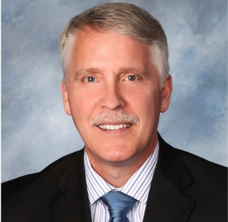

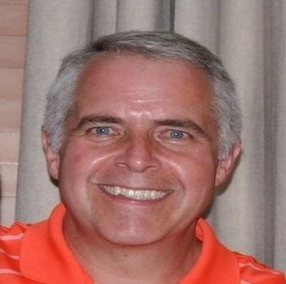
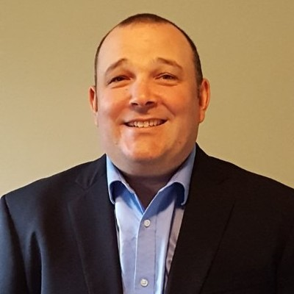
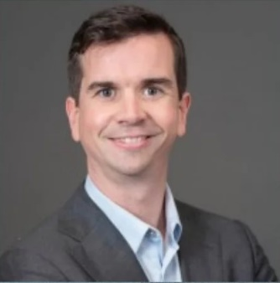
Questions and Follow up with the Presenters
Wayne Cobleigh
GZA
wayne.cobleigh@gza.com
William Pfleger
Schneider Electric
william.pfleger@se.com
Tom Vignale
Schneider Electric
tom.vignale@se.com
Stephen Bern
Citizens Energy Corporation
sbern@citizensenergy.com
Rees Sweeney-Taylor
MassCEC
rsweeney-taylor@masscec.com

