Slide 1
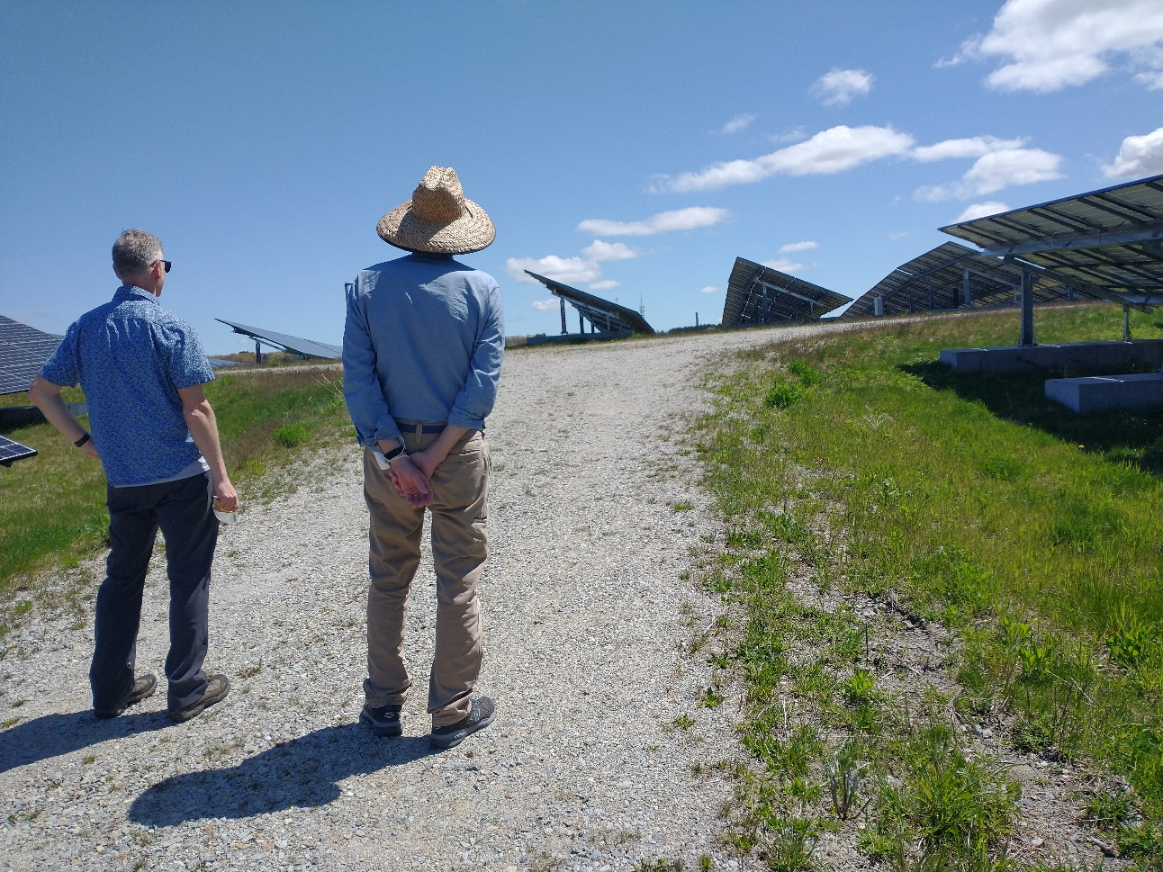
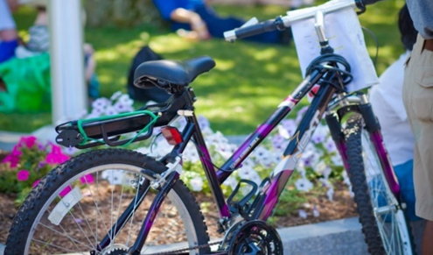
CMRPC’s Municipal Energy Planning Lunch & Learn Virtual Workshop Series Improving Energy Efficiency in Municipal Buildings: Successes, Challenges, and Strategies
Department of Sustainability & Resilience | Luba Zhaurova, Director of Projects | June 22, 2022

Slide 2
About Worcester – Municipal Statistics
2021 Budget - $722 M
5,500 city employees
25,000 students in pre-K through 12th grade
90+ Municipal Buildings – 53 of those are public school buildings
6.5 Million SF
14,000 streetlights

Slide 3
Energy Savings Performance Contract
Agreement (2009) with Honeywell International to be the City’s Energy Services Company (ESCo)
90+ buildings, IGA
100s of energy conservation and renewable energy measures
5 Phases (typical ECMs, solar, street lights, indoor lights, IAQ)
$100+ million in investments via bonds
$164 million in savings and other benefits
Notes:
Computer managerment program, building management systems, lighting, insulation

Slide 4
The Green Worcester Sustainability & Resiliency Plan (2021)
Vision – The country’s greenest mid-size city
Goals including:
By 2030 – 100% renewable energy for municipal facilities
By 2035 – 100% renewable electricity citywide
By 2045 – 100% renewable energy in all sectors, including heating and transportation
Require new buildings to be net zero, and stimulate deep energy retrofits of existing buildings
Promote climate resiliency and healthy homes programs
www.WorcesterMA.gov/GreenWorcester
Notes:
municipal electricity aggregation vehicle allowed for municipalities in Massachusetts and purchasing more green electricity than is the default now via state’s Renewable Portfolio Standard

Slide 5
Thank you!
Q&a
Contact the Department of Sustainability & Resilience at greenworcester@worcesterma.gov.

